Slide 1
Grants and Funding Management System (GFMS)
Requestor Training
July 2023

Slide 2
Submitting a Grant Request

Slide 3
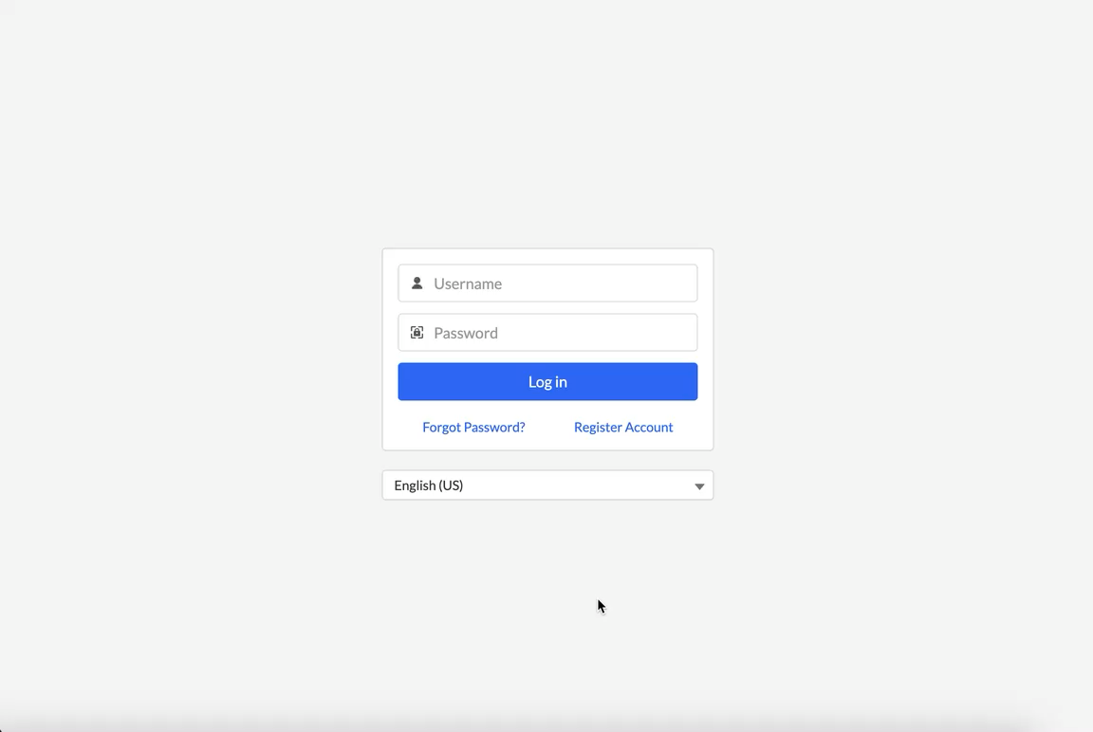
Registration
Please use the following link to take you to the GFMS system: https://eisaigfms.my.site.com/grants
Click on ‘Register Account’
Enter all details and submit
You will receive an email with the link to set a password
Screencast:
https://www.screencast.com/t/nnFkmlm0x

Slide 4
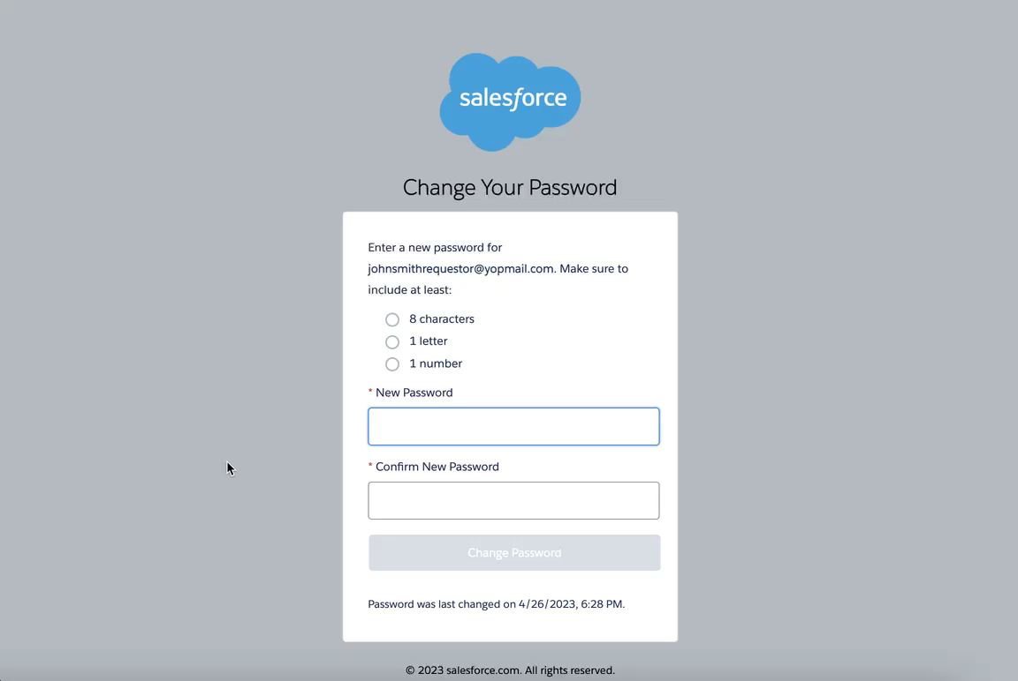
Setting Your Password
Once you have registered, you will receive an email
Click on the set password link provided in the email
You will be routed to set a password
Once your password is set, requestor is routed to the GFMS inbox
Screencast:
https://www.screencast.com/t/p74o8qaJ

Slide 5
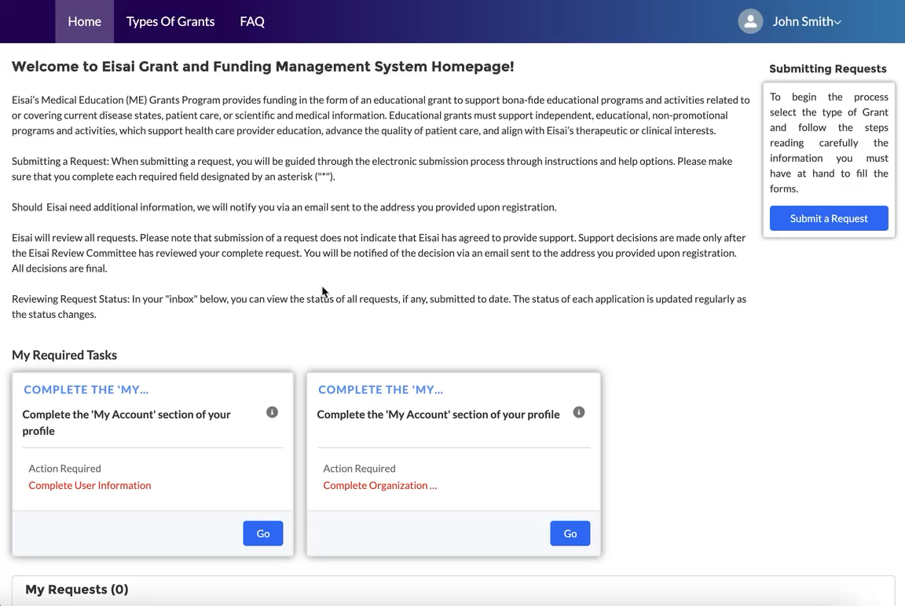
Completing the User Profile
In the requestor’s inbox, click on the ‘Go’ button in the Complete User Information Action card
Enter all required information and save
Please fill out all information requested in both the ‘User Information’ section and the ‘Organization Information’
Organization Information:
  Click the ‘New’ button in Organization Information
  Search for the Organization. If no match is found, click the next button to add a new organization
  After the organization is added to your profile, please click on the organization hyperlink to enter the remaining information:
    Organization Details
    Organization Name and Contact Details
    Address Information
    Files
    Tax Identifiers
    Authorized Signer
    Payee Information
    Third Parties
When you are finished you can click on the Home button on the top left-hand corner to submit your request
Screencast:
https://www.screencast.com/t/00INptXUt9k

Slide 6
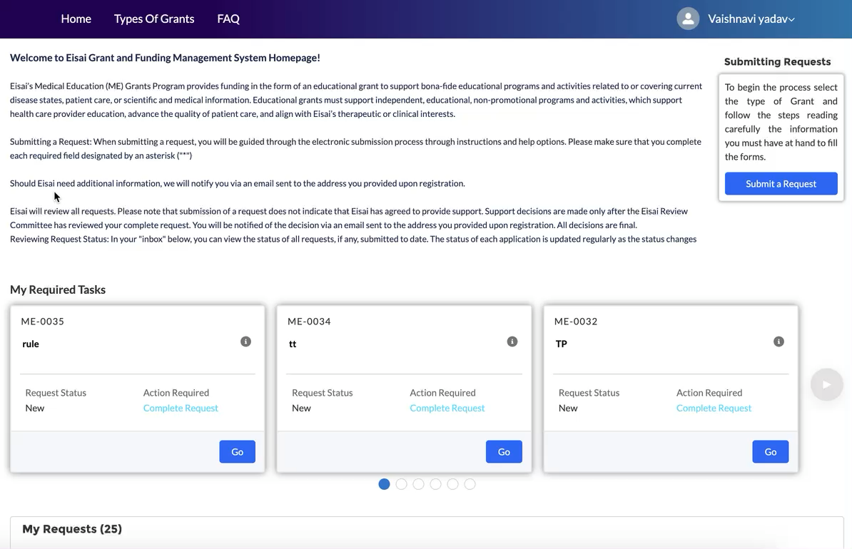
Dashboard & Home Screen
Tabs include the following
  Home
  Types Of Grants
  FAQ
Requestor Inbox consists of the following Dashboard items:
  On the Home screen:
    Submitting Requests
    Action Cards:
      My Required Tasks
    My Requests
    Requestor metrics:
      Total Amount Requested
      Total Amount Approved
      Total # of Requests
  Screencast:
  https://www.screencast.com/t/RgMrJXqDs

Slide 7
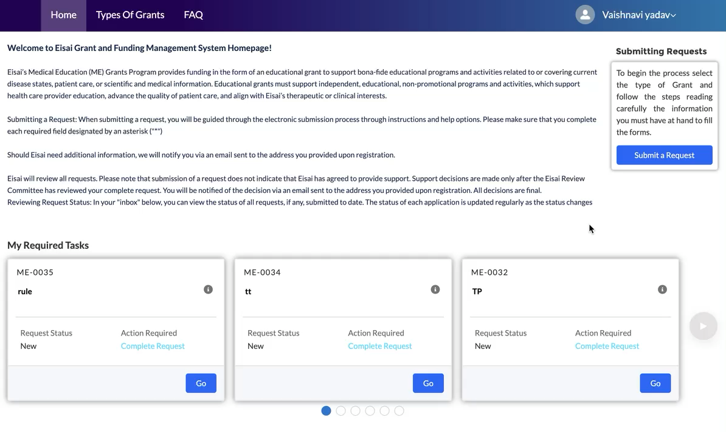
Submitting a New Request
Click on the ‘Submit a Request’ button
From the pop-up select the type of Request and click Next
Enter summary details and click the ‘Create’ button
Requestor is routed to the full request form
The following Tabs should be filled out completely:
    Request Information
    Needs Assessment
    Activities
    Budget
    Document Uploads
    Third Parties
    Authorized Signer
    Payee Information
Once all the above information is entered, please submit the grant application
The request will now be visible in the ‘My Requests’ section
Screencast:
https://www.screencast.com/t/NxRGvs8H

Slide 8
Tips for Submission of Request

Slide 9
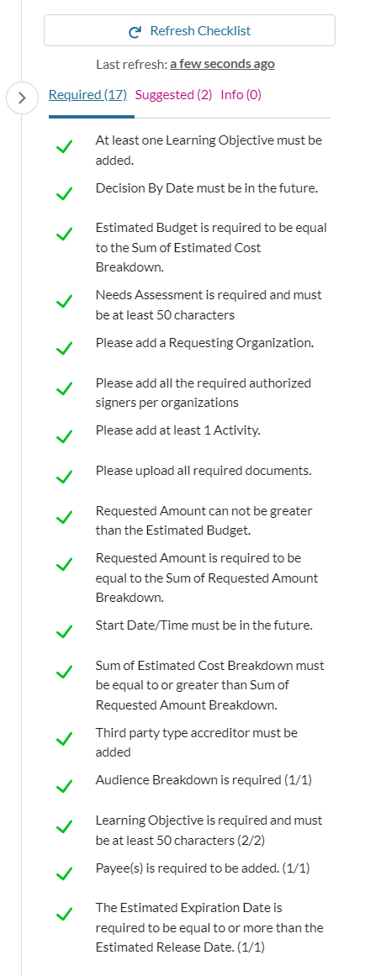
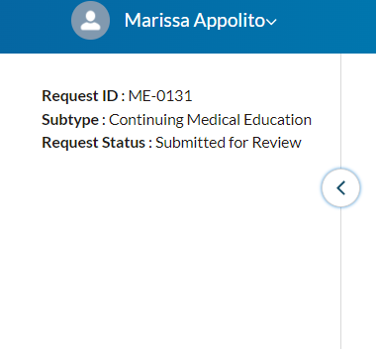
Collapsible Panel (Right)
The arrow on the right-hand side of the screen hides a collapsible panel which shows the rules for the grant application
Click on the arrow to open this section
The rules that need to be satisfied will turn green after the information is entered into the application
Once all the rules are green, you should be able to submit your application

Slide 10
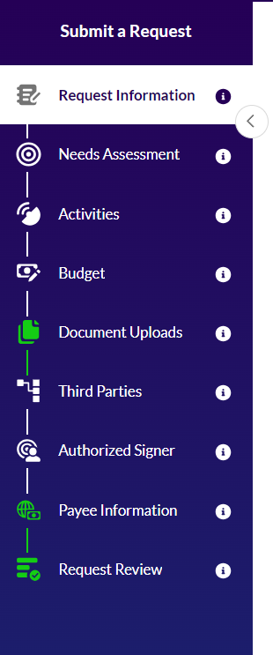
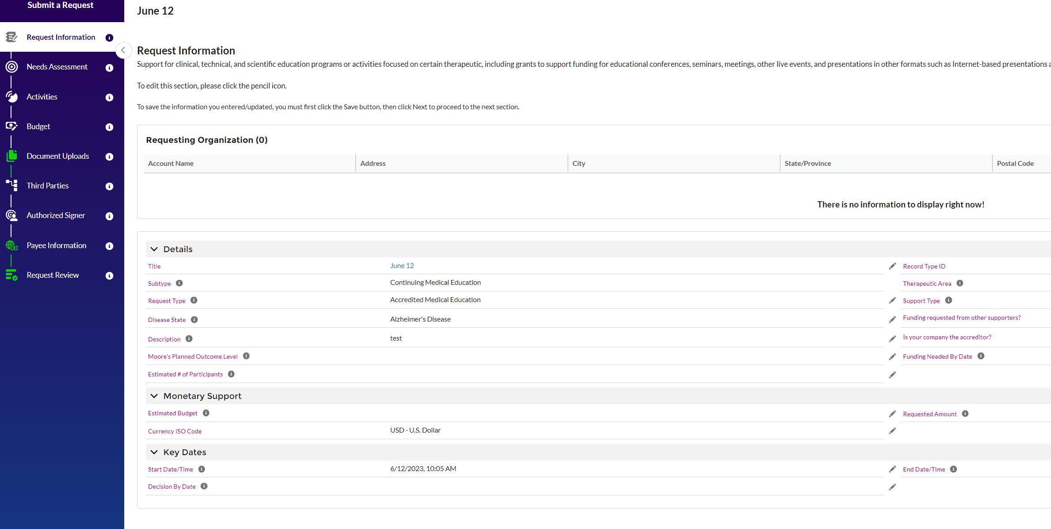
Collapsible Panel (Left)
The arrow on the left-hand side of the screen hides a collapsible panel which shows each tab that needs to be completed per each grant application
Click on the arrow to open this section
After clicking on ‘Next’ at the bottom of each tab, if all the information is entered correctly the tab name will light up green
Once all the tabs are green, you should be able to submit your application

Slide 11
Reconciliations

Slide 12
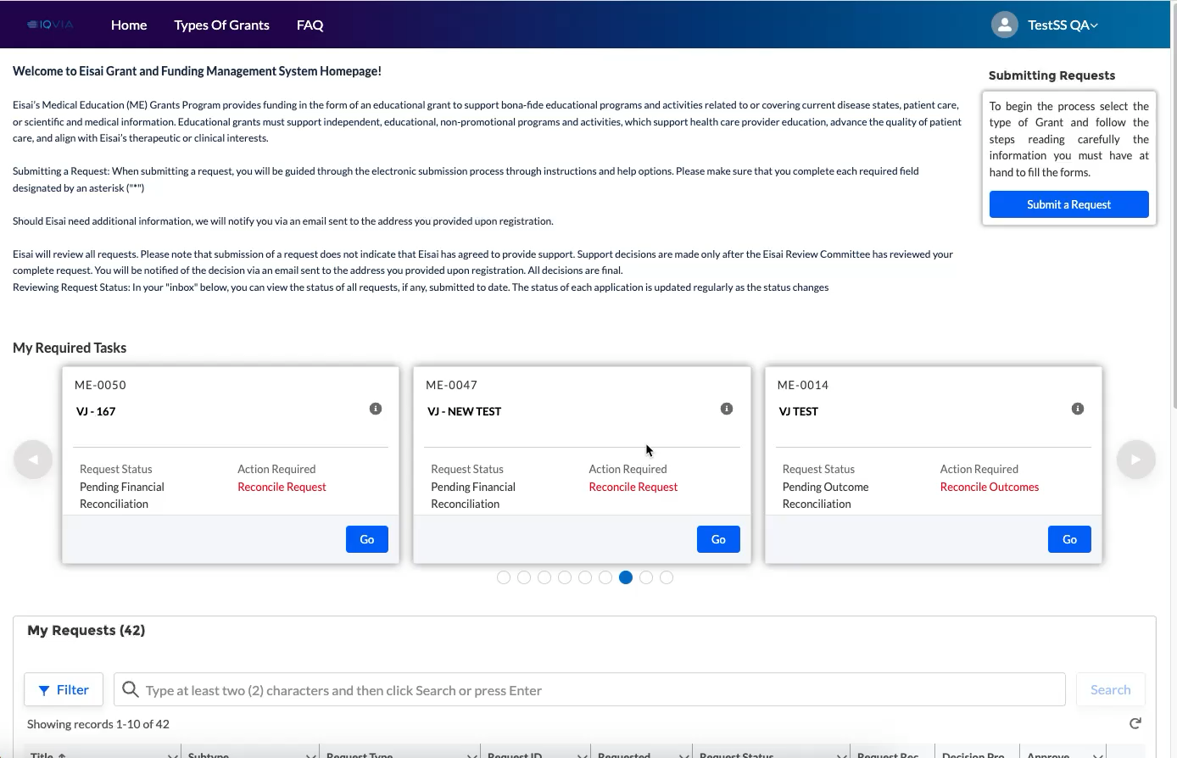
Submit Reconciliation
When a request is pending reconciliation, it shows up under ‘My Required Tasks’
Click the ‘Go’ button for the request card. This will load the Reconciliation form
Requestor needs to complete all required info in all tabs and submit.
    Activities
    *Attendees (Only If speakers were given funds for Honoraria, Travel, Hotel, etc.)
    Budget
    *Refund (If all Eisai funds were not used, remainder would be money owed to Eisai)
Screencast:
https://www.screencast.com/t/c7TwlNGY8o

Slide 13
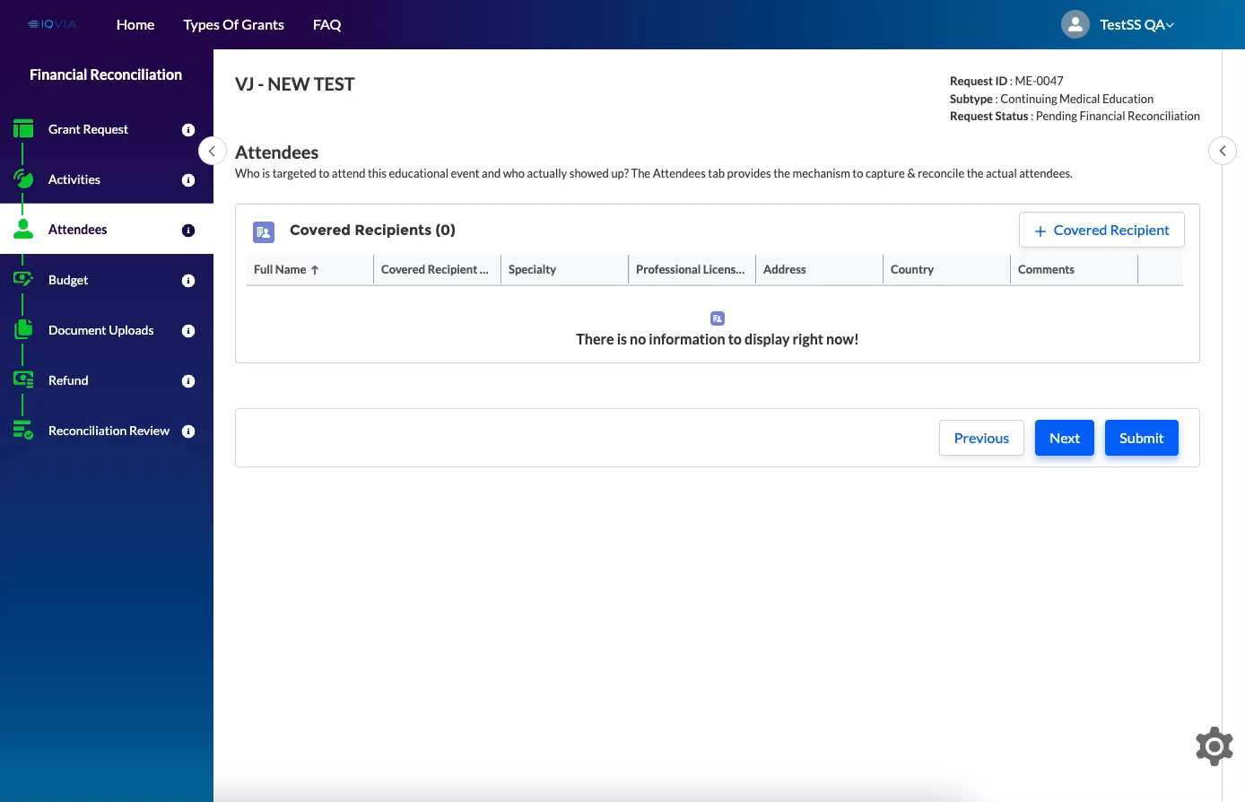
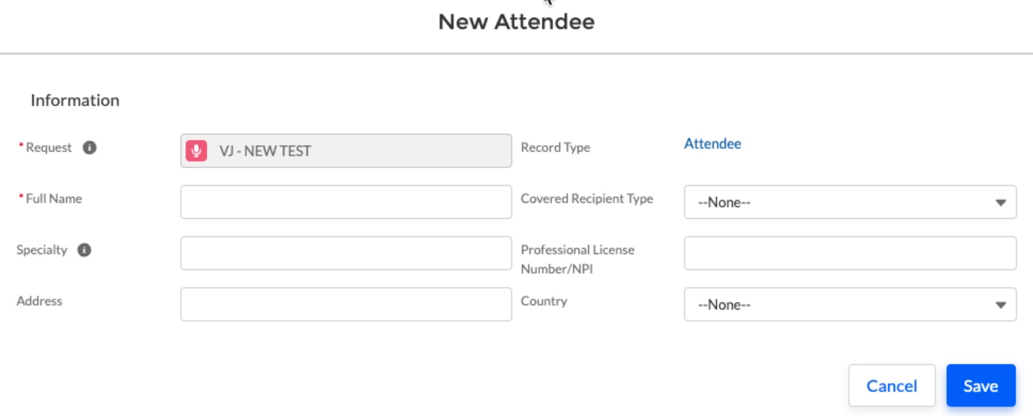
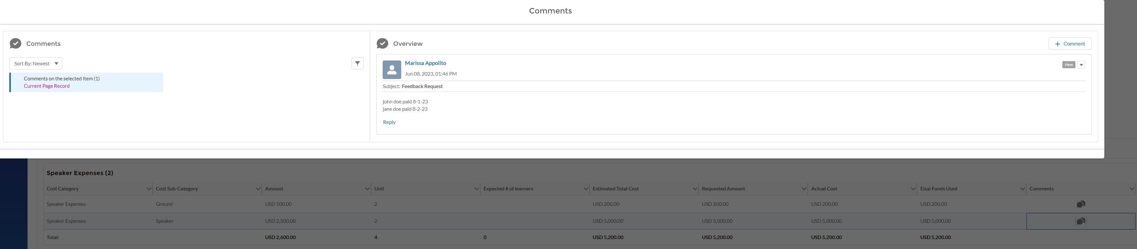
Adding Covered Recipients
(Speakers)
In the Attendees tab, click on ‘+ Covered Recipient’
New Attendee tab opens – enter all required info and click ‘Save’
Click Next > go to Budget tab > Speaker Expenses
In the comments section, click on ‘+ comment’ and add the dates the speakers were paid
Add Speaker Expenses for all Speakers added
#1
#3
#2
#5
Screencast:
https://www.screencast.com/t/4G5oL6sfhhg
#4

Slide 14
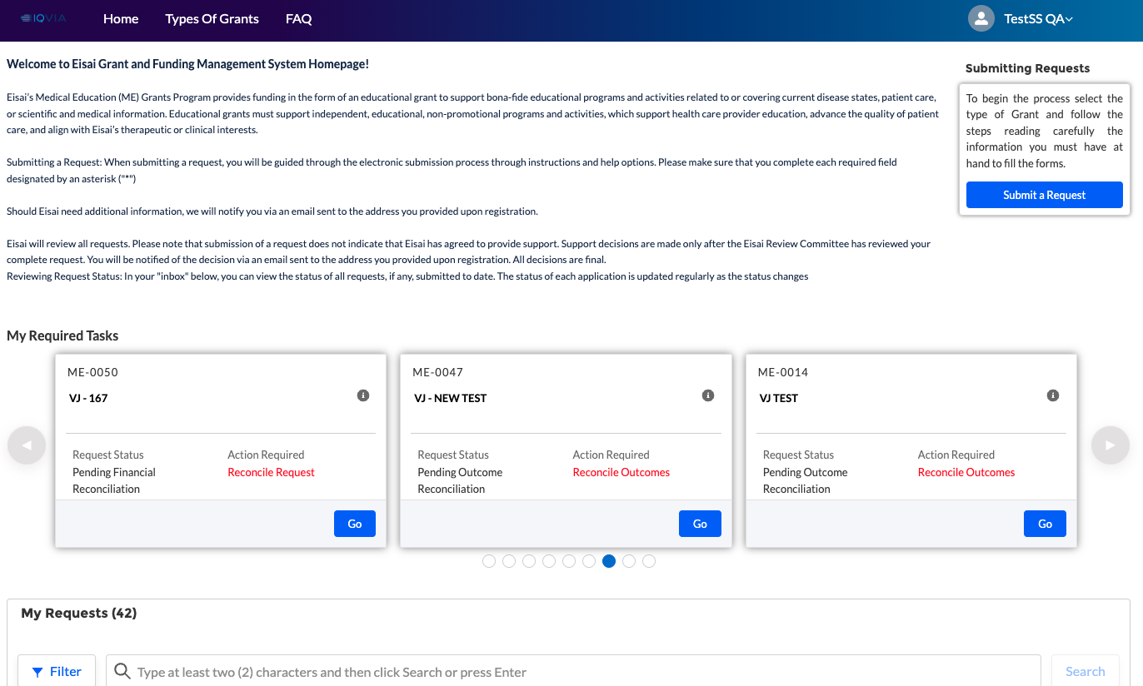
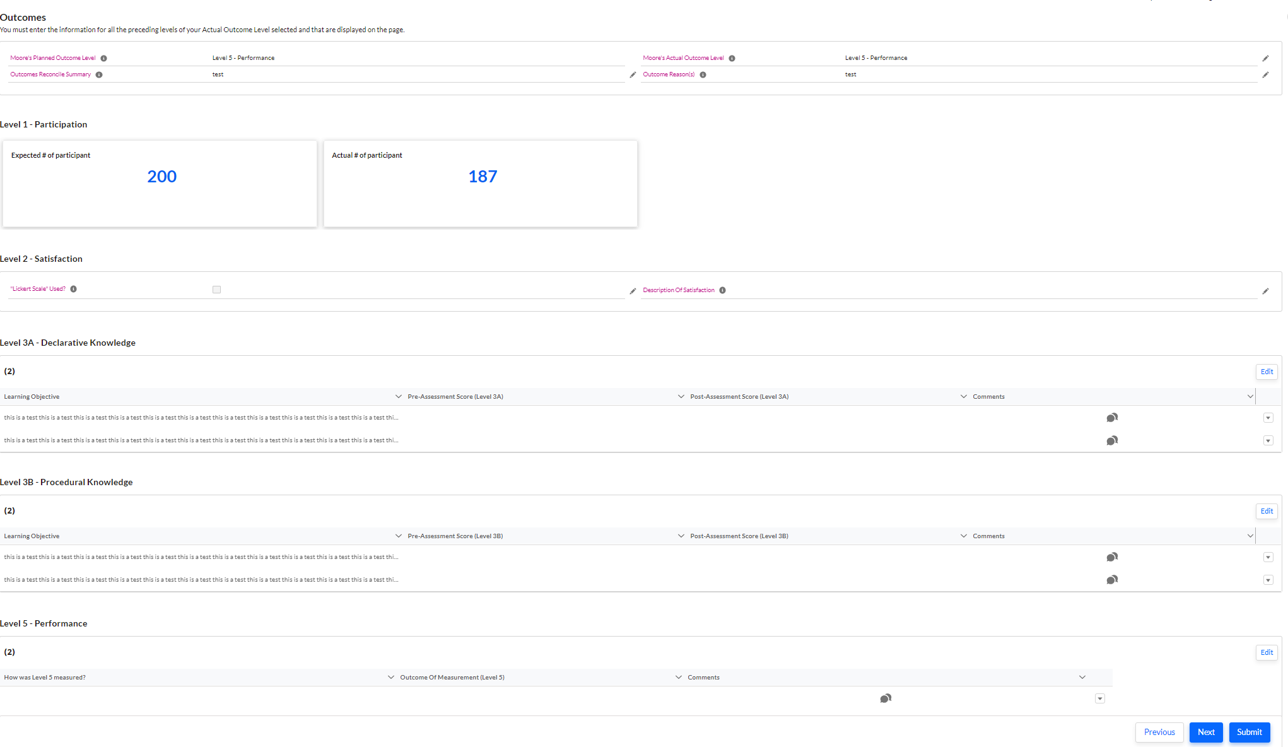
Submit Outcome Reconciliation
When a request is pending outcome reconciliation, it shows up under ‘My Required Tasks’
Click the ‘Go’ button for the request card. This will load the Outcome Reconciliation form
Requestor needs to complete all required information in the Outcomes tab and submit.
    Within this tab you will need to fill out all levels of outcomes that were completed

Slide 15
General Tips

Slide 16
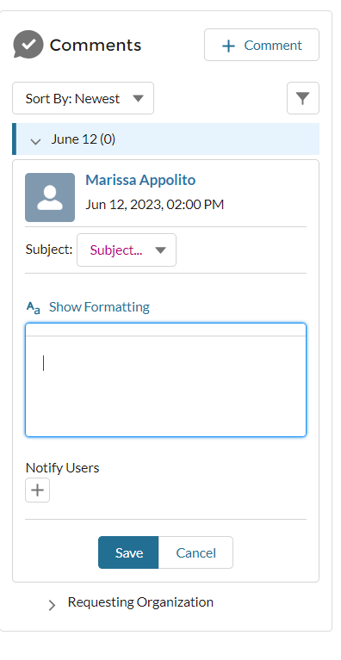
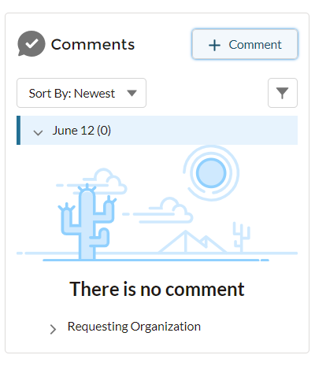
Comments Box
The Comments box should be used to provide any of the following:
    Missing or additional information
    Clarification requests
    Feedback requests
    How-to
    General Questions
    Request Revision
    Speaker Payment Dates
To add a new comment, click on the ‘+ comment’
Select the subject and enter your question in the test box
You can notify your Eisai MedEd contact that there is a comment in your application by clicking on the ‘+’
When finished click on save
#1
#2
#3
#4
#5

Slide 17
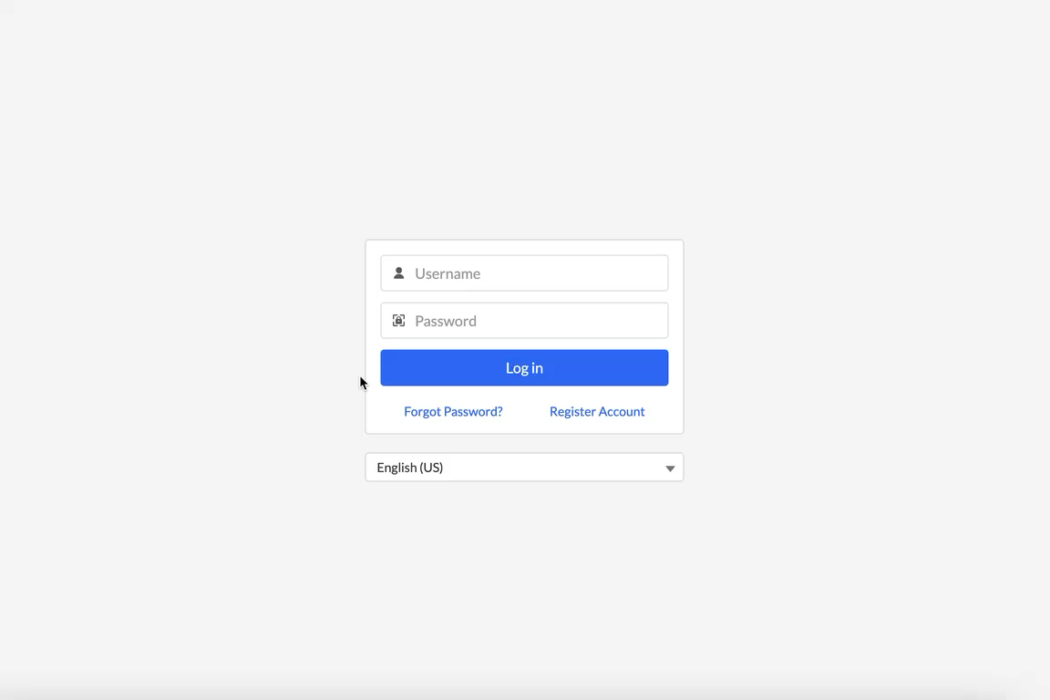
Resetting Password
From the login page, click ‘Forgot Password’
User will be routed to the Password Reset page
Enter the username / email address and click Reset password
Follow the link provided in the email sent to the requestor’s email inbox
Set the new password.
Screencast:
https://www.screencast.com/t/pci60fpdCeru

